Slide 1

SMART INDIA HACKATHON 2026
Aiva Nex Agent — Privacy-Preserving Browser AI Agent
Problem Statement ID – SIH26171
Problem Statement Title - On-device Visual Perception for Light-weight Browser Agents
Organization - Indian Space Research Organisation (ISRO)
Theme - Smart Automation
PS Category- Software
Team ID-
Team Name (Registered on portal): Aiva Nex

Slide 2
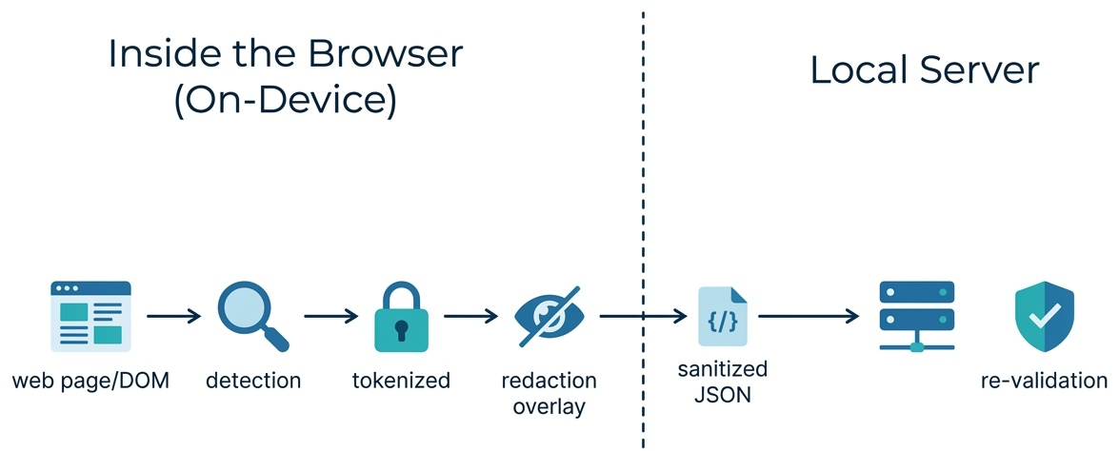
IDEA TITLE
Aiva Nex
Idea Title: Aiva Nex Agent — a Privacy-Preserving Browser AI Agent
Proposed Solution:
• Chrome extension (Manifest V3) + local FastAPI server acting as an AI agent inside the browser
• Implements on-device screen perception via structural DOM analysis (a lightweight, fast alternative to pixel-level vision for structured web forms) — detects sensitive fields (passwords, OTP, Aadhaar/PAN-like IDs, card numbers, email, phone, name, address, hidden tokens) entirely on-device
• Every sensitive value tokenized locally (e.g. EMAIL_1, PERSON_1, PASSWORD_FIELD) before anything leaves the browser — no raw PII or screenshot ever leaves the device
• Sanitized “screen graph” (JSON) — page title, domain only, form structure, field labels/types, tokenized values, approximate positions — sent to a local server
• Server independently re-scans the payload for PII shapes as a defense-in-depth backstop and rejects anything that looks raw
• Server decides one browser action (click / focus / scroll / summarize) — using a real local LLM (Ollama/LM Studio, OpenAI-compatible API) when available, falling back to a deterministic rule engine when not
• Extension executes that action back on the real page (e.g. focus the OTP field, click “Upload Certificate”, summarize the page)
How it addresses the problem:
• Solves the core tension in AI browser agents — usefulness requires understanding page content, but sending raw page data (especially forms with PII) to any server is a privacy/compliance risk
• Gets the benefit of page understanding and automated action without ever transmitting sensitive data
Innovation and uniqueness:
• Client-side-first architecture: detection, classification, tokenization, and visual redaction overlay all
happen before data leaves the browser
• Defense-in-depth: server independently re-verifies no PII leaked through, not just trusting the client
• Hybrid decision engine: uses a real local LLM when present but never breaks — automatic fallback to rules
keeps the agent reliable even with zero AI installed
• Fully local/offline-capable — no cloud dependency required for the core privacy guarantee

Slide 3
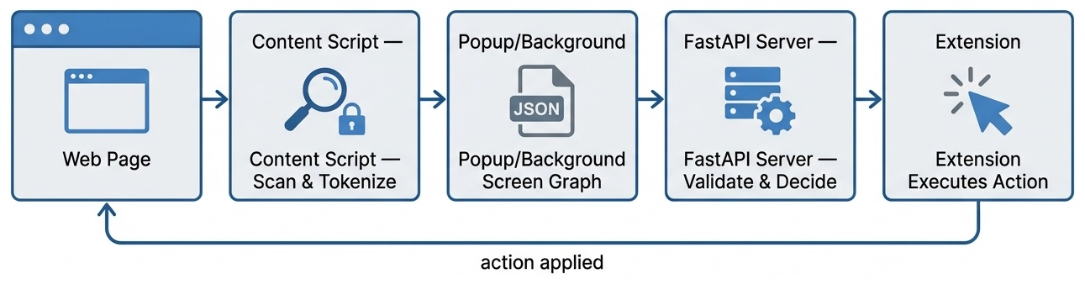
TECHNICAL APPROACH
Aiva Nex
Technologies:
• Frontend/Extension: Chrome Extension Manifest V3, plain JavaScript (no build step/framework)
• Backend: Python 3.11+, FastAPI, Pydantic
• Local AI (optional): any OpenAI-compatible local LLM server — Ollama (llama3.2:1b, qwen2.5:0.5b), LM Studio, Jan — via stdlib urllib, no extra dependency
• Detection: on-device screen perception via regex pattern matching + DOM label/placeholder heuristics (a lightweight, structural alternative to pixel-level vision models — no heavy ML libraries needed server-side)
Methodology / flow:
• Content script scans the DOM, detects sensitive fields, and tokenizes + redacts them locally
• Sanitized “screen graph” JSON sent via background worker → POST /analyze
• Server re-validates for raw PII, then decides one action — local LLM first, rule-engine fallback
• Extension executes the action back on the live page (see diagram below)

Slide 4
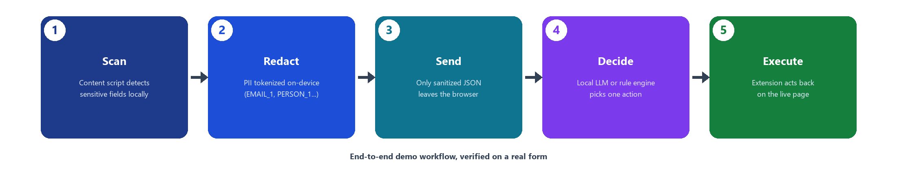
FEASIBILITY AND VIABILITY
Aiva Nex
Feasibility:
• Fully working prototype already built and tested end-to-end (scan → redact → send → decide → execute) on a real demo form
• No heavy infrastructure needed — runs entirely on localhost, no cloud costs, no GPU required
• Uses only mature, well-supported tech (Chrome Extensions API, FastAPI, optional local LLM runtimes)
Potential challenges & risks:
• Name/address detection is label-based heuristic, not true NER — may miss unlabeled free-text PII
• Small local LLMs (0.5B–1B params) can be slow or occasionally produce malformed output
• Pattern-based PII checks (Aadhaar/PAN/card) are shape-based, not checksum-validated
• No authentication on the local server (acceptable for a local prototype, would need hardening for production)
Mitigation strategies:
• Rule-based fallback guarantees the agent never breaks even if the LLM fails or is absent
• Server-side re-validation (defense-in-depth) catches any client-side redaction gaps
• Roadmap: upgrade to a lightweight local vision model for pixel-level screen understanding, plus real NER, checksum validation, and auth for non-local deployment

Slide 5

IMPACT AND BENEFITS
Aiva Nex
Target audience:
• Any internet user filling sensitive forms online (scholarship/job/government portals, banking, healthcare)
• Organizations wanting AI browser automation without compliance risk
Impact:
• Enables AI-assisted browsing/form-filling without the privacy trade-off users currently accept with cloud-based AI agents
• Directly relevant to India's data protection goals (DPDP Act) — no PII transmitted or stored off-device
Benefits:
• Social: builds public trust in AI agents handling personal/government data (Aadhaar, PAN, scholarship forms)
• Economic: reduces liability/compliance cost for organizations deploying browser AI agents
• Environmental/technical: lightweight local-first design reduces reliance on constant cloud inference calls
• Security: reduces attack surface — no sensitive data in transit or server logs to breach

Slide 6
RESEARCH AND REFERENCES
Aiva Nex
Chrome Extensions Manifest V3 documentation — developer.chrome.com/docs/extensions
• FastAPI documentation — fastapi.tiangolo.com
• Ollama (local LLM runtime) — ollama.com
• OpenAI /v1/chat/completions API spec (compatibility target for local LLM integration)
• India's Digital Personal Data Protection (DPDP) Act, 2023 — motivation for privacy-by-design approach
• Project repository: github.com/Jothik1506-ai/AIVA-NEX

